Slide 1
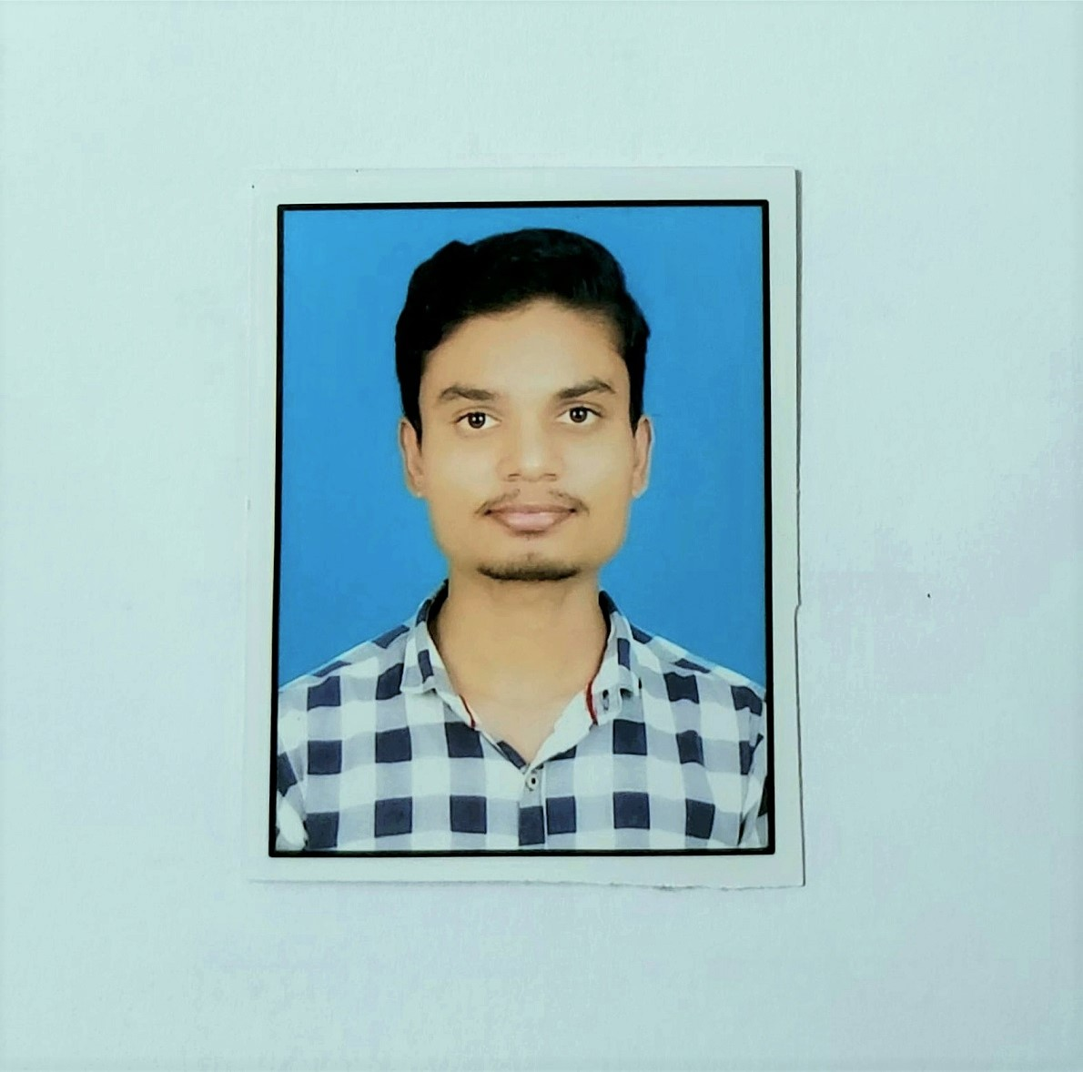

ADITYA SHETE
Analyst/Software Engineer
Bachelor of Engineering
Electronics and Telecommunications & Eng:2017-2021
Skills
Mumbai
Aditya.shete@capgemini.com
Java | Java Basics, OOPS;
Spring | Spring microservices, RestApi Spring Security.
Testing | Junit Testing.
UI Framework-Angular | Fundamentals components ,Type Script, Routing ,Life Cycle Method, Working with HTTP in Angular.
Database | MongoDB
UI Tech | HTML 5 & CSS 3,TypeScript, Optimized UI Designed
Tools | Visual Studio code, Swagger, Postman, STS.
Add On skills | Communications, Team management. Peer learning
+91 7507451102
A4
Proficient in Java and OOPs concepts.
Hands on experience in creating Web Application with Spring Boot, Java, Rest API, Angular.
Hands on experience in developing web pages using HTML5, CSS3, TypeScript, JSON.
Practical understanding of rendering Spring Boot, REST API.
Implemented Rest API and Angular in case study and up skilling this knowledge continuously.
Agriculture Crop System
Working on end-to-end case study of Agriculture Crop System along with authentication, Swagger and Angular used for user interface.
Java and Angular for web developers in Degreed Platform
Completed this course with optimal Knowledge of Web API , RESTFUL services , Components.
Check out my work on GitHub

